Slide 1

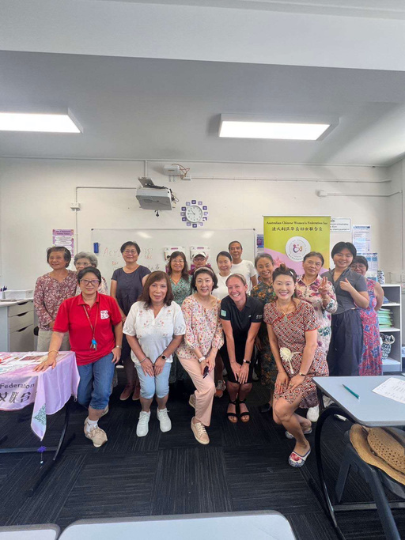
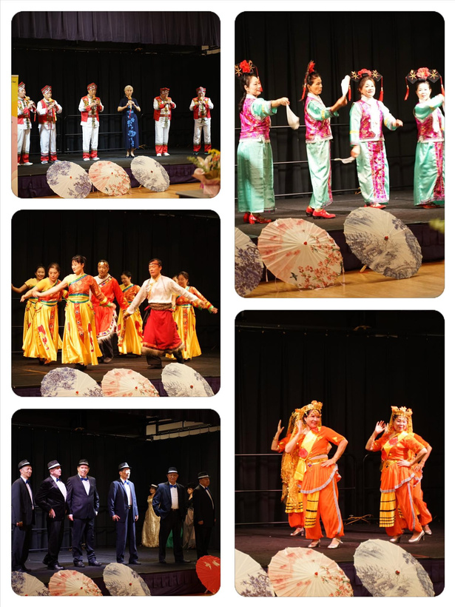



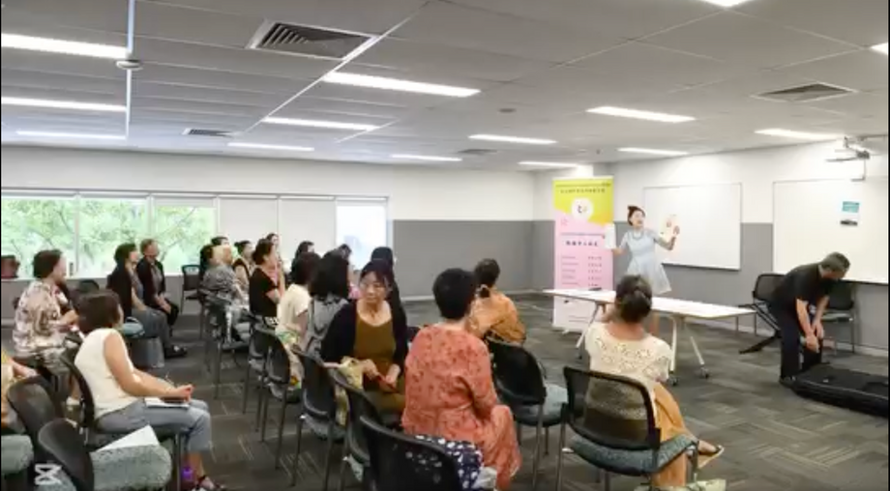

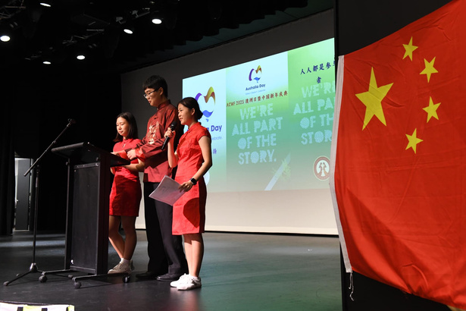
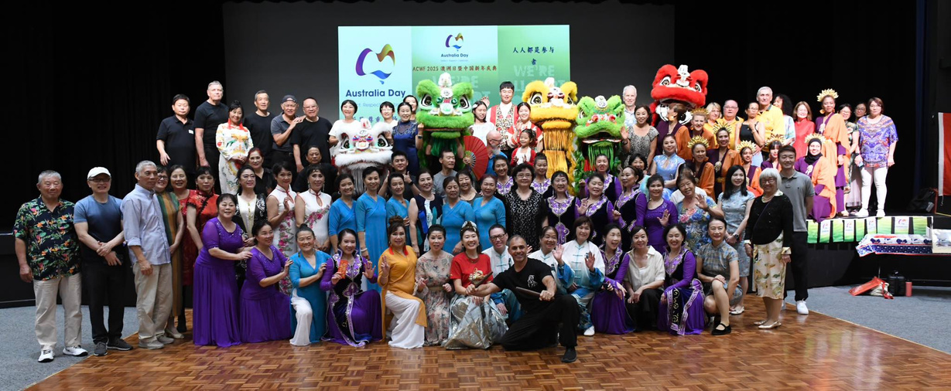
2025 Mid-Year Report

Slide 2
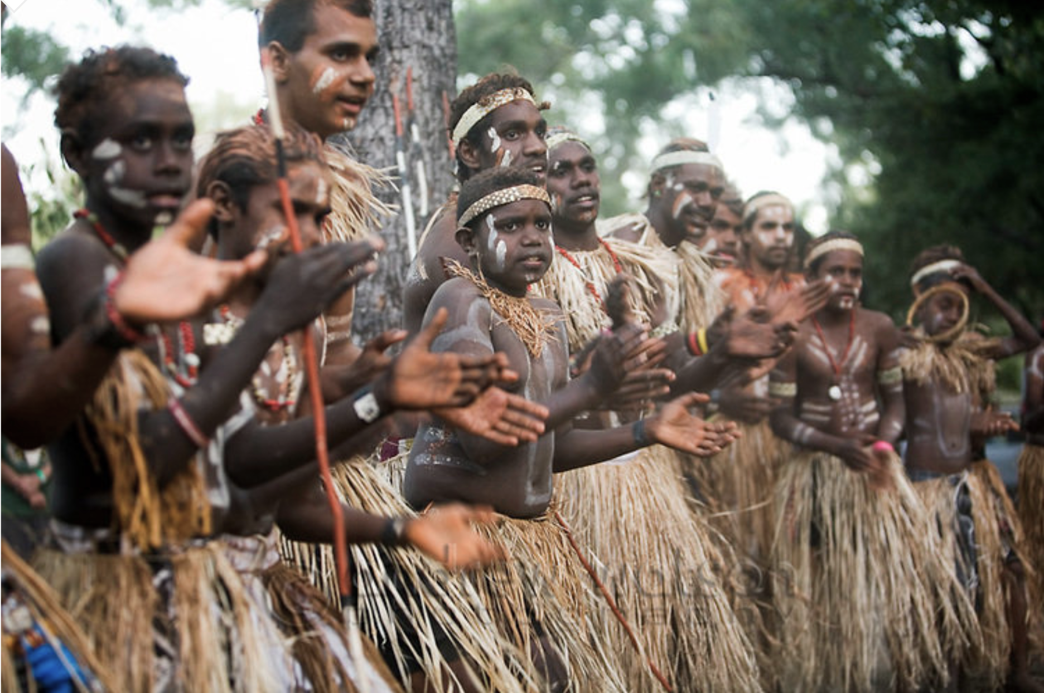
Acknowledgment of Country
Asian Women Association acknowledges the Traditional Custodians of the land on which we are meeting and pays respect to the Elders, past and present, and extends that respect to all Aboriginal and Torres Strait Islander people.

Slide 3
About Us
  联结与协助澳洲华人融入当地生活
  Connecting & Supporting Chinese Communities to create a sense of belonging
  积极乐观 Optimism
  团结互助 Community
  不断学习 Learning
  品质生活 Lifestyle
  享受快乐 Enjoyment

Slide 4


Chinese Cultural Fair
20 June 2025

Slide 5

Chinese Club
17 June 2025

Slide 6
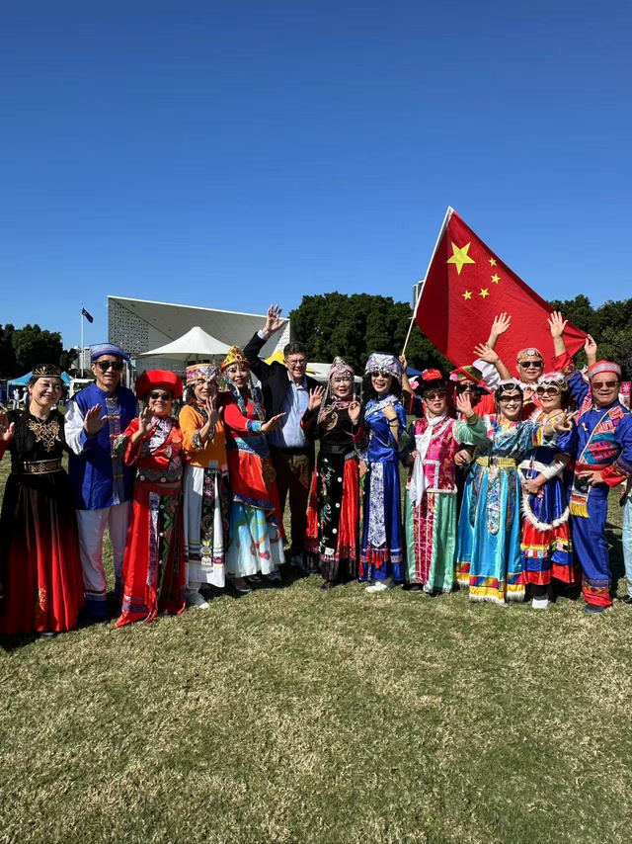
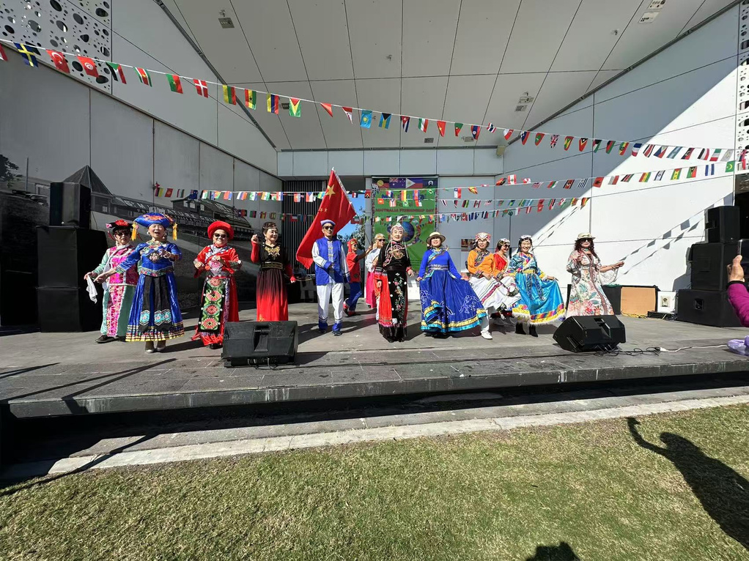
Multicultural Festival
24 May 2025
Australia Friendship Day
Borad Water Parklands, GC

Slide 7
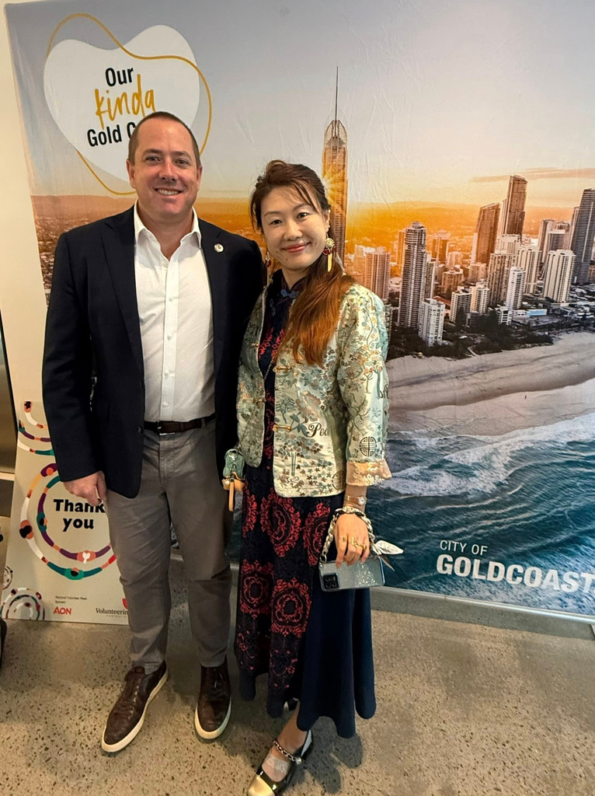
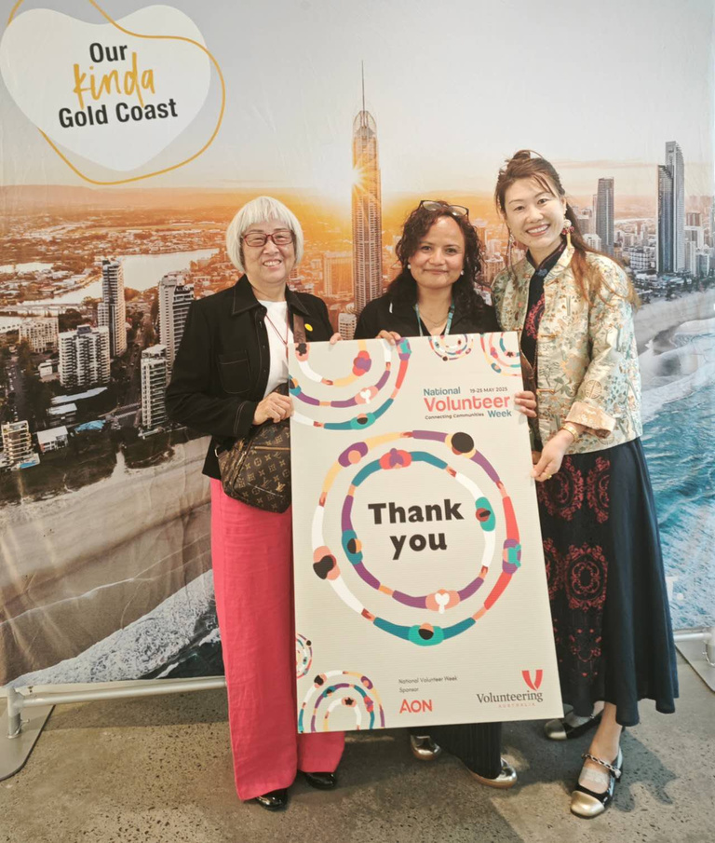
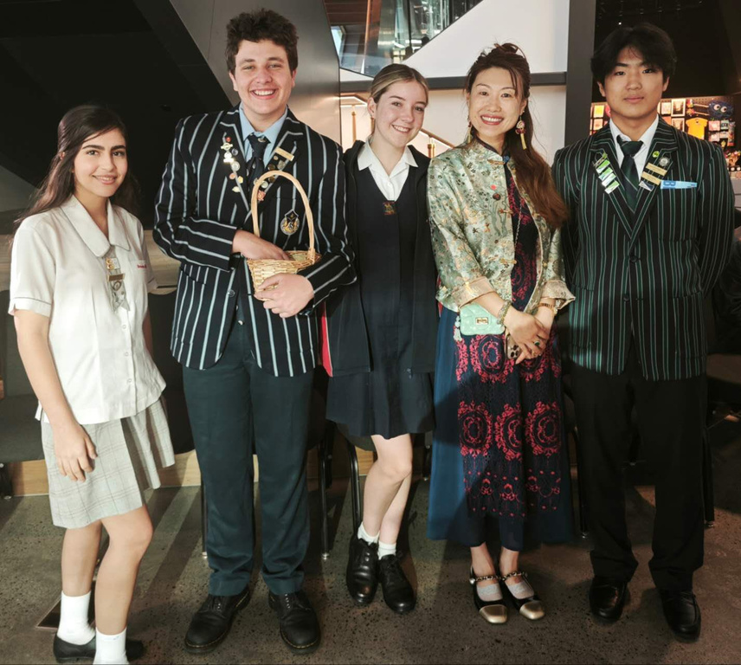
Thank you Volunteering
19-25 May 2025
National Volunteer Week

Slide 8

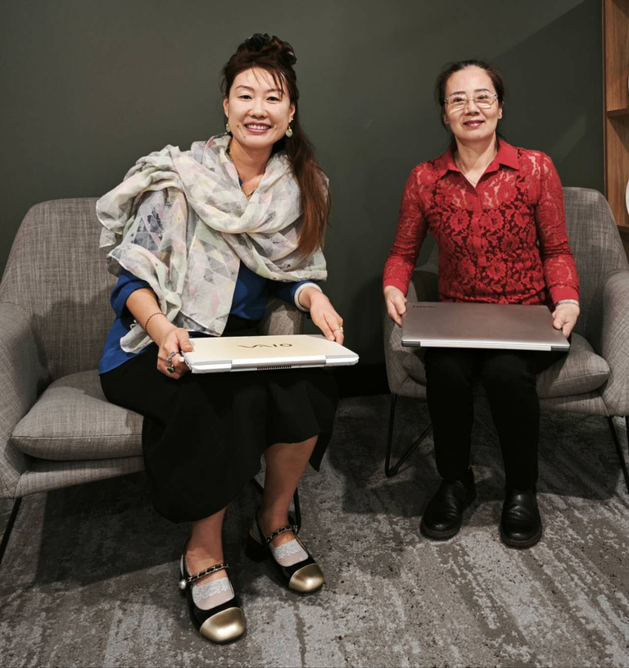
AWA Digital Devices
community support
Starting from 14 May 2025

Slide 9


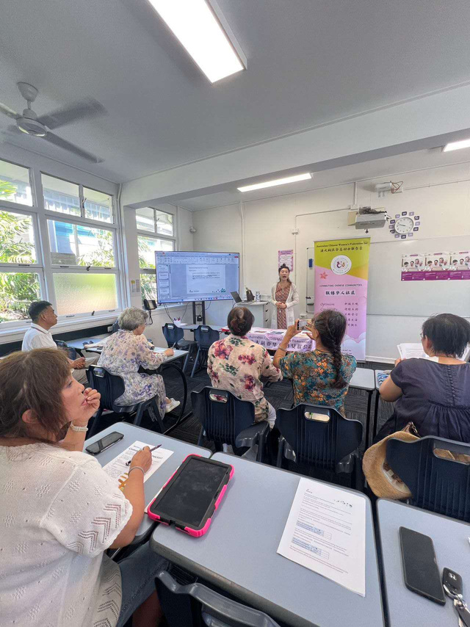
Digital Skills Class
Monthly
Tongxin Chinese School

Slide 10
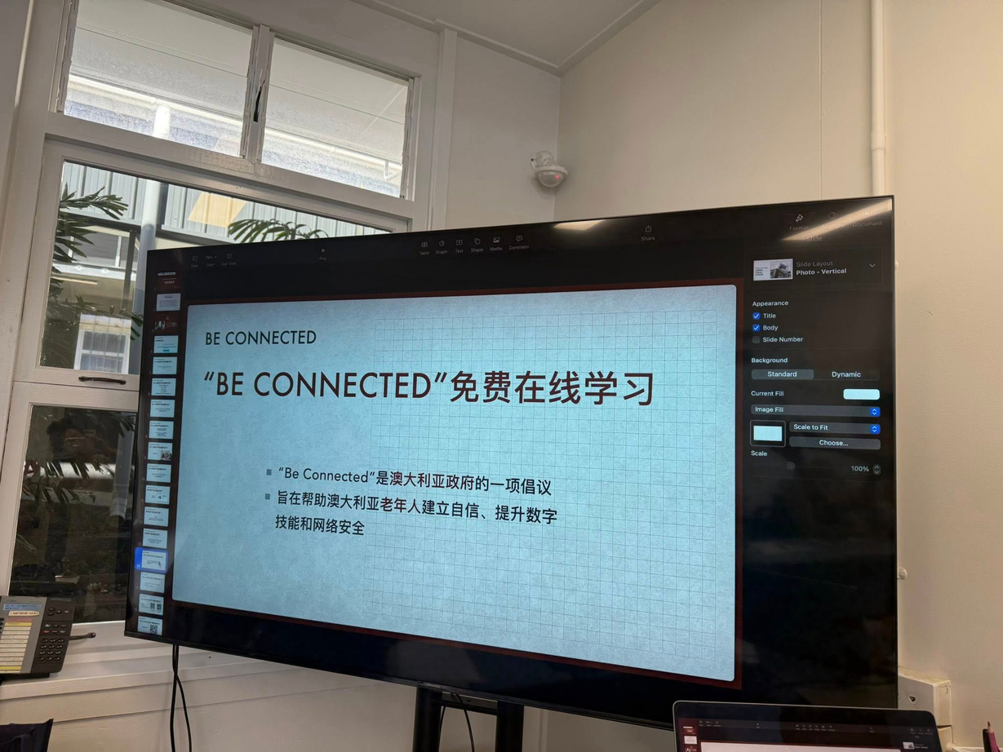
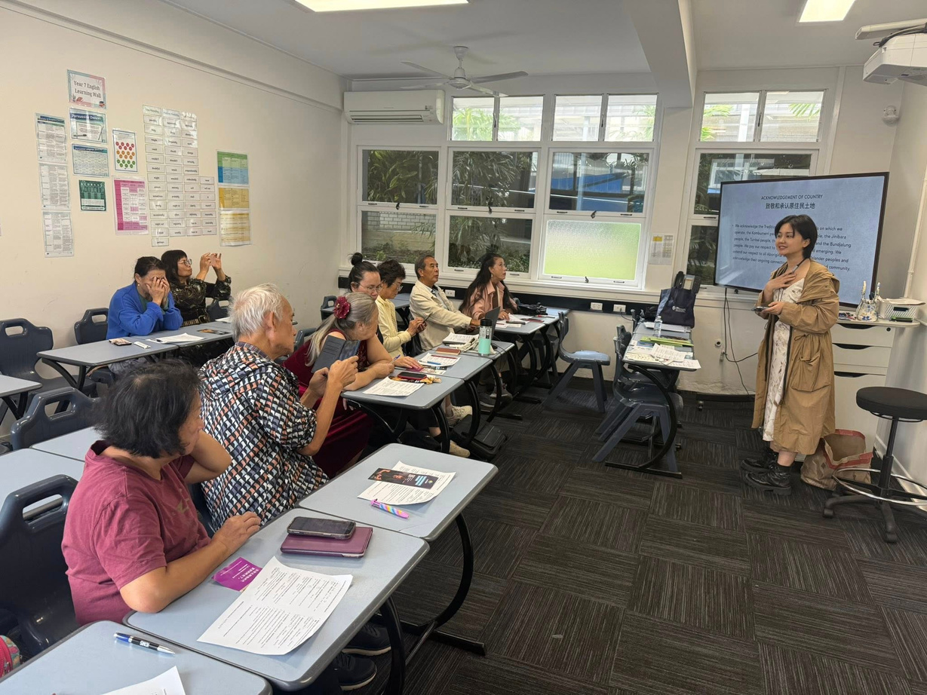
Digital Skills Class
Monthly
Tongxin Chinese School

Slide 11
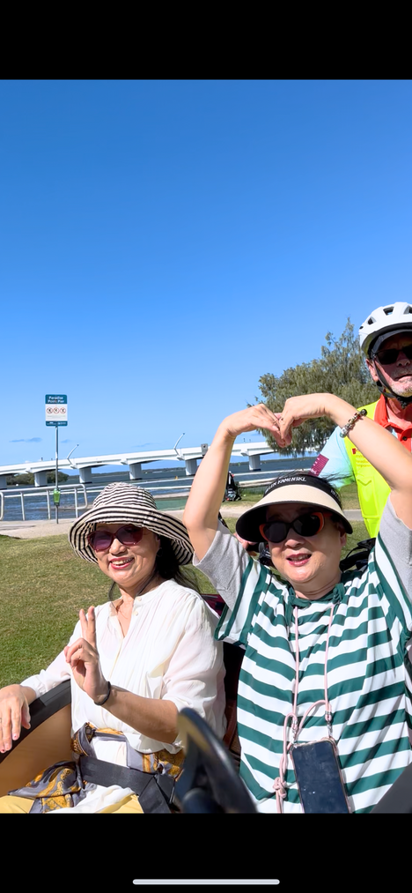
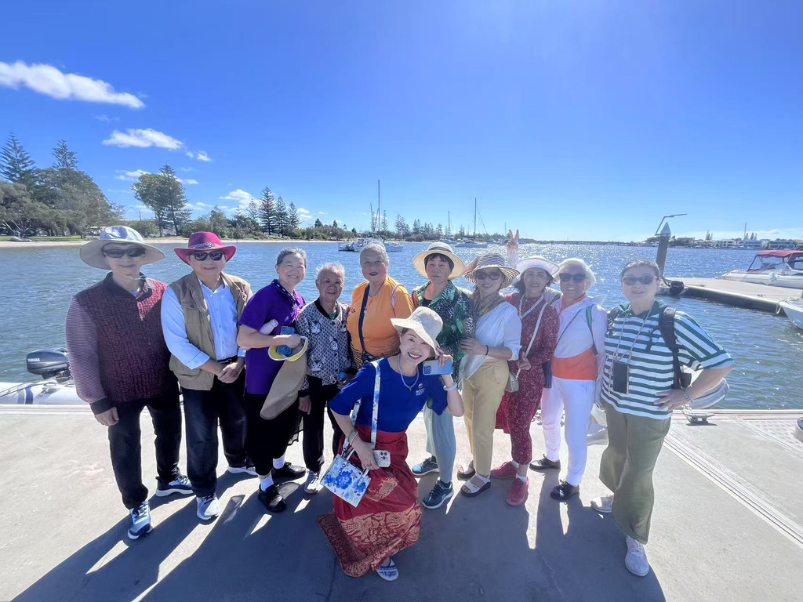
Cycling Without Age
Chinese Club for senior 65+ outdoor activity
29 April 2025

Slide 12
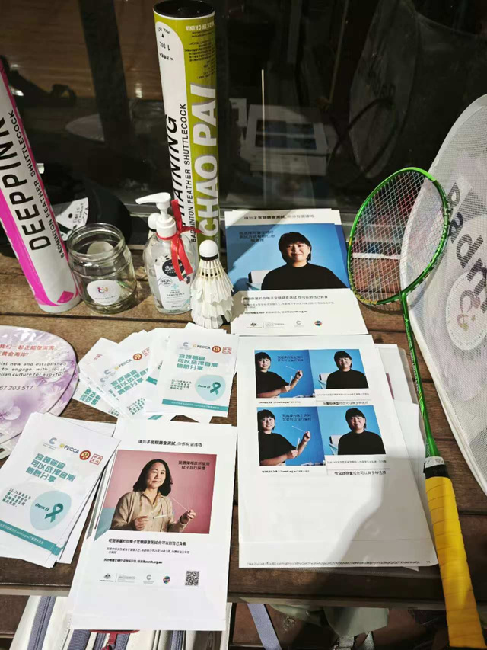
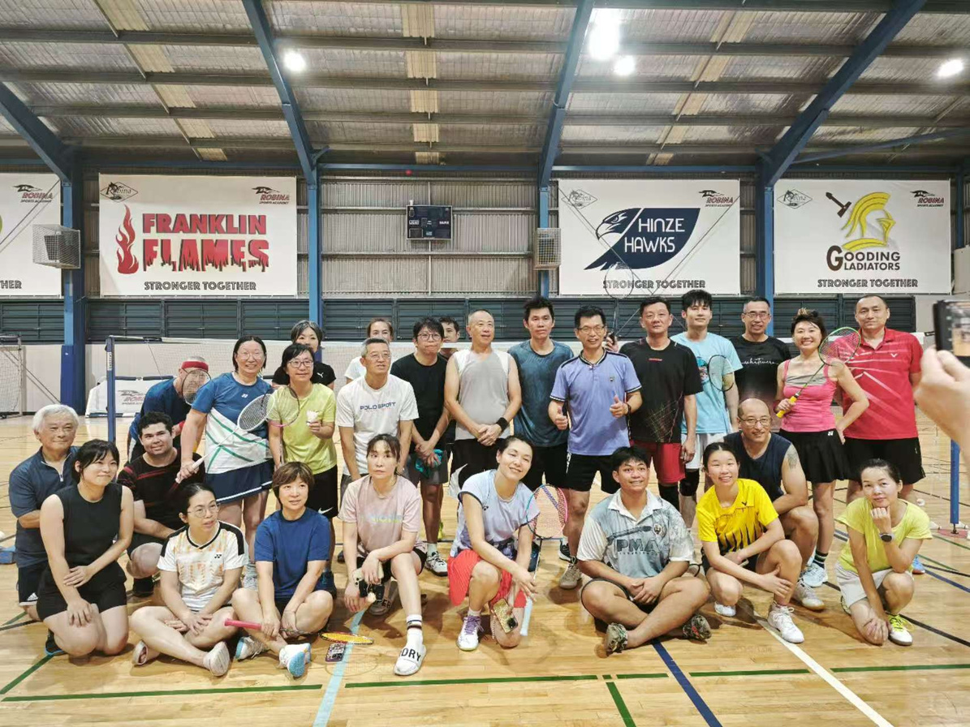
Social Badminton Game
every Friday night
Robina State High School

Slide 13
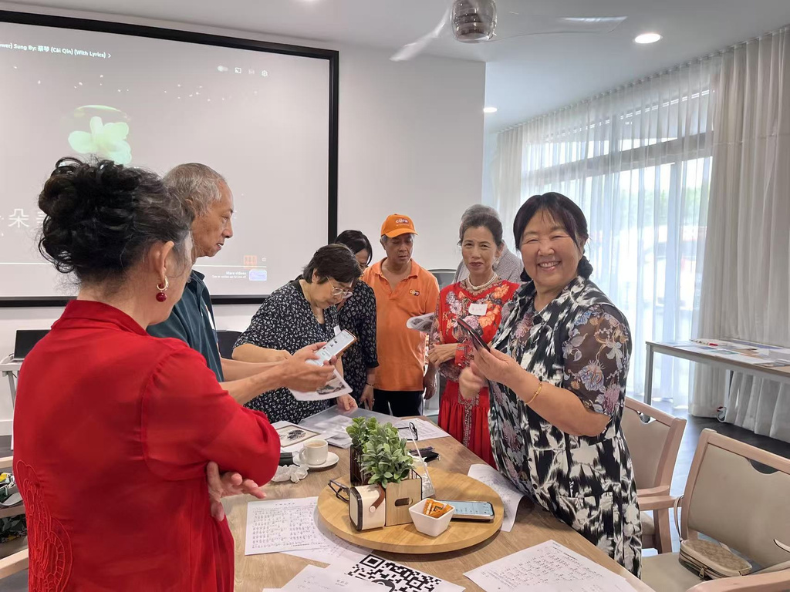
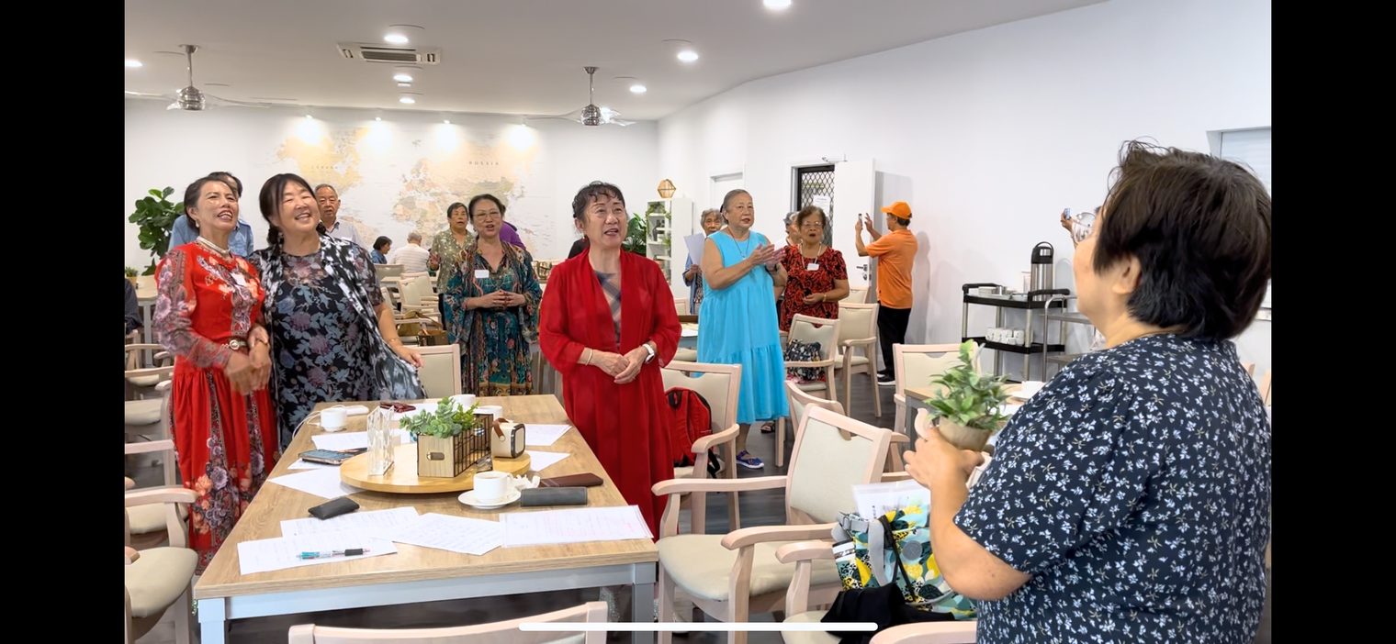
Chinese Club
8 April 2025

Slide 14


EGG strava ganza
6 April 2025
Frascott Park

Slide 15

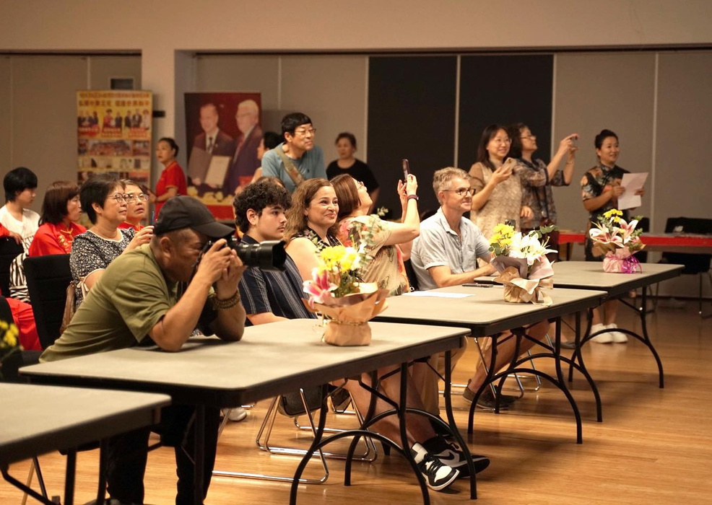
International Women’s Day Celebration
22 March 2025

Slide 16
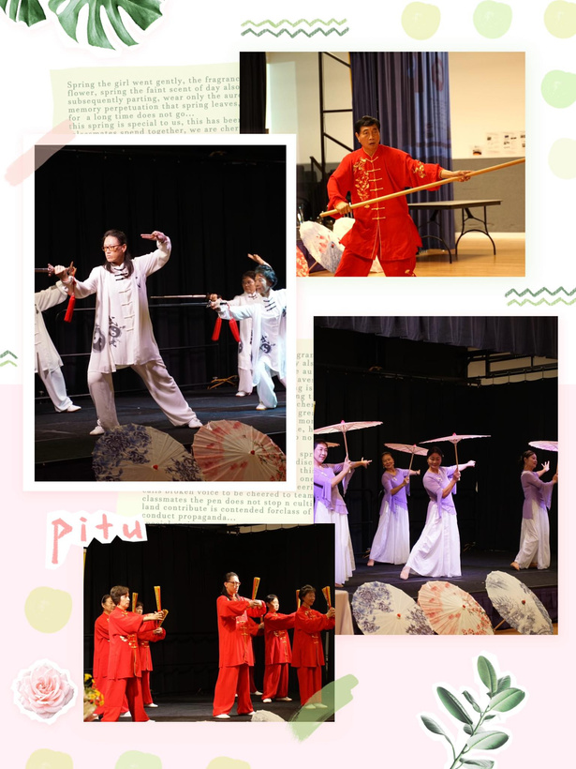
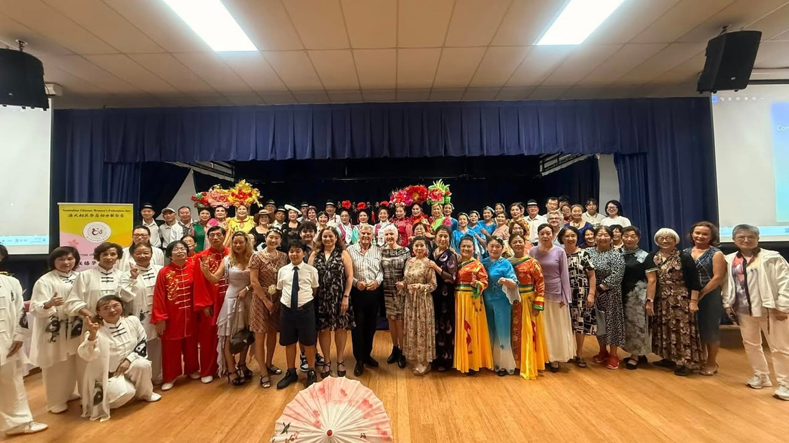
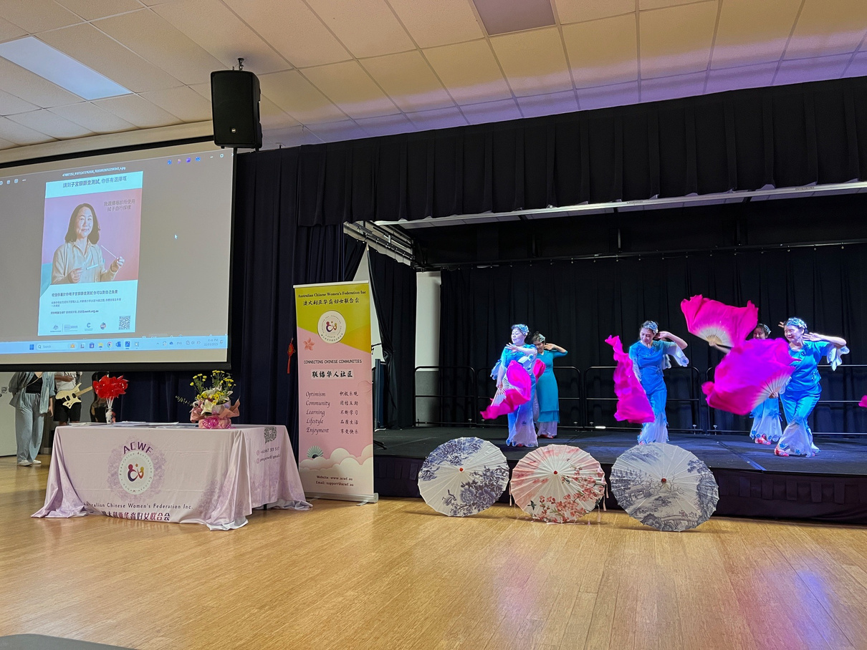
International Women’s Day Celebration
22 March 2025

Slide 17

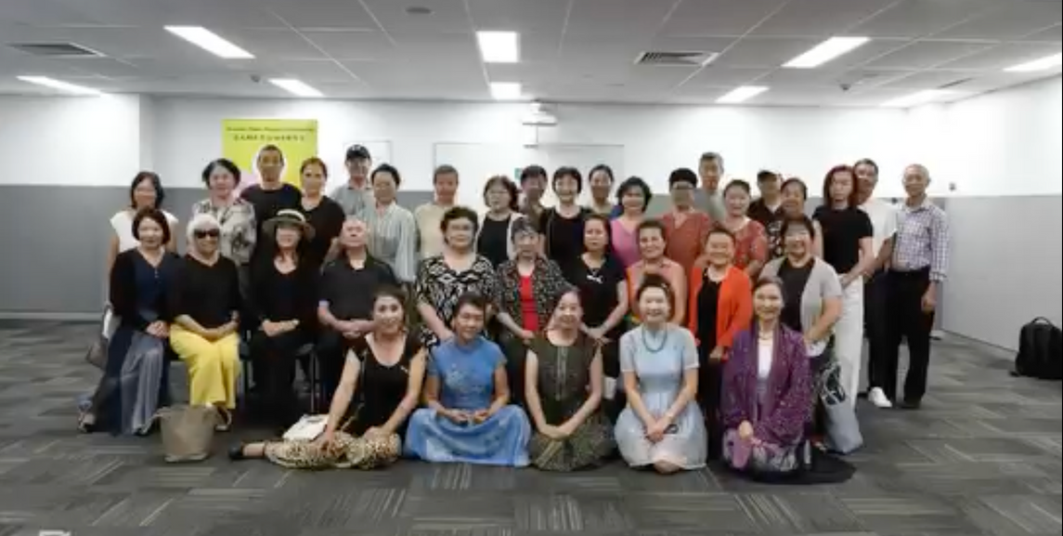
Own it - Cervical Cancer Self Collection Campaign
15 Feb 2025

Slide 18
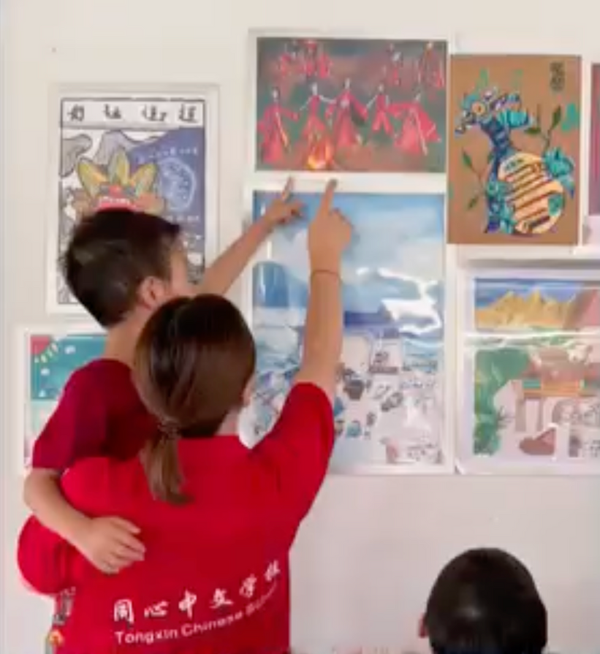
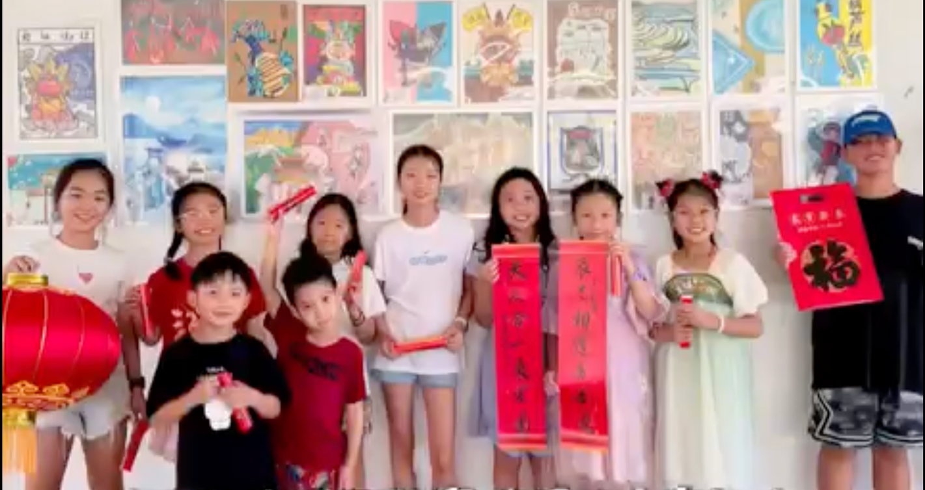
“有一种叫云南的生活之非遗走进澳大利亚” 少儿美术展

Slide 19

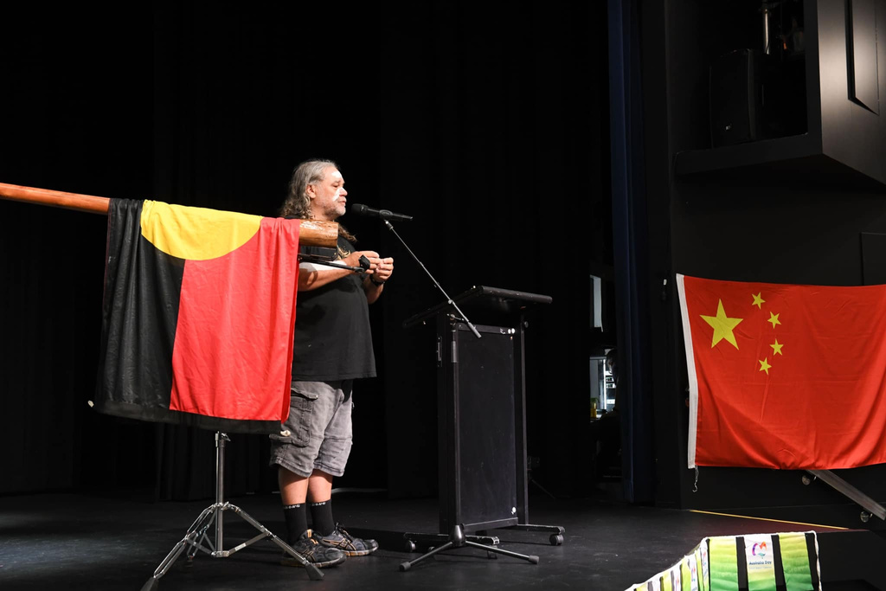
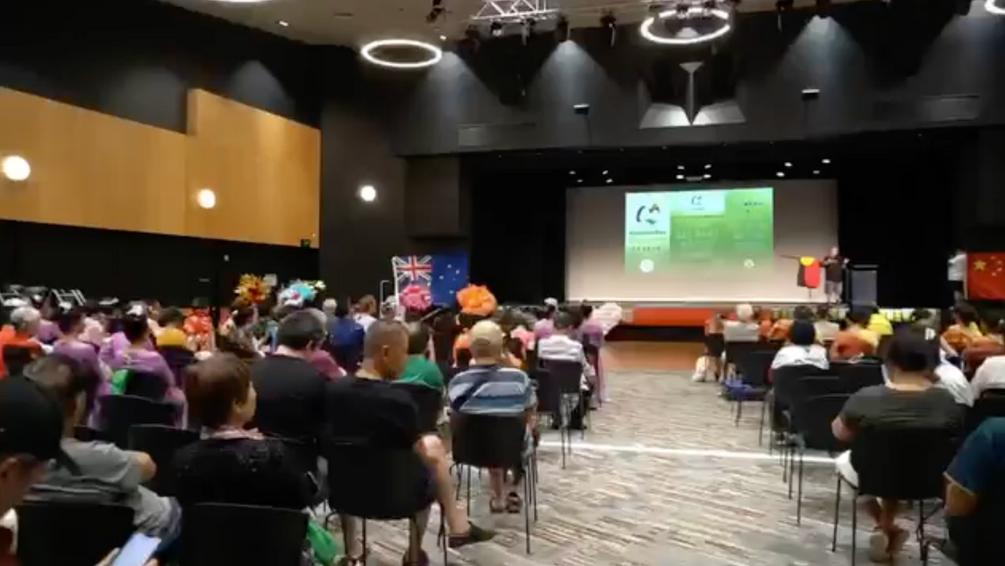
2025 AWA Australia Day Celebration
26 Jan 2025

Slide 20
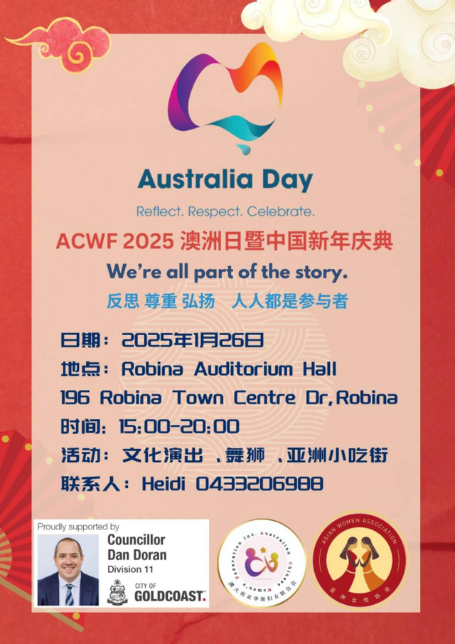

2025 AWA Australia Day Celebration
26 Jan 2025

Slide 21


2025 Year of Snake Chinese Art Exhibition
Robina Art Gallery
21 Jan- 3 Feb 2025

Slide 22
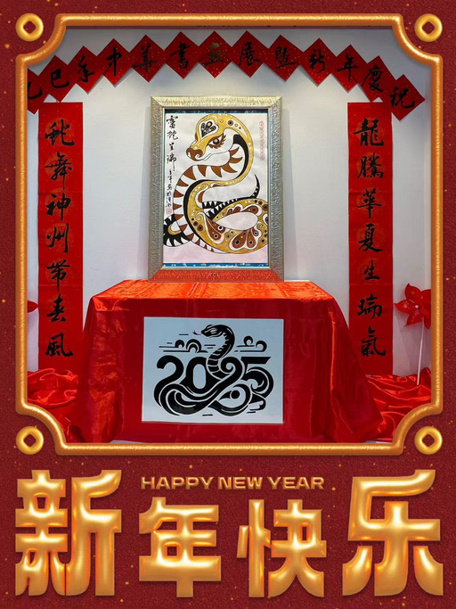
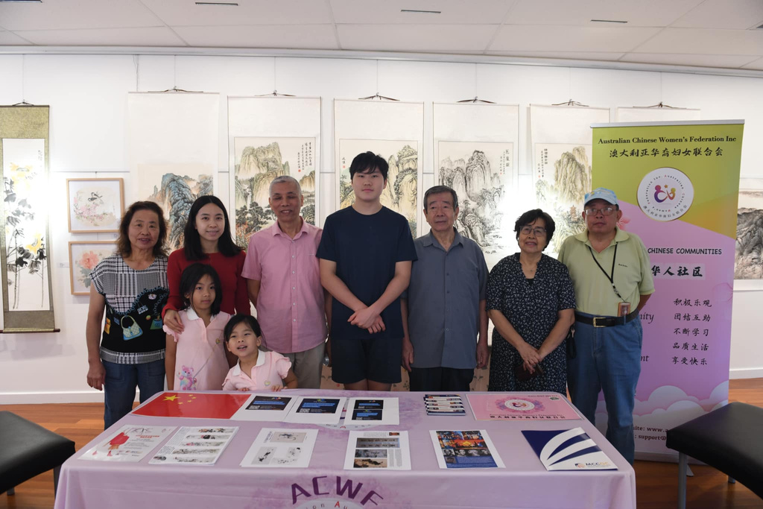
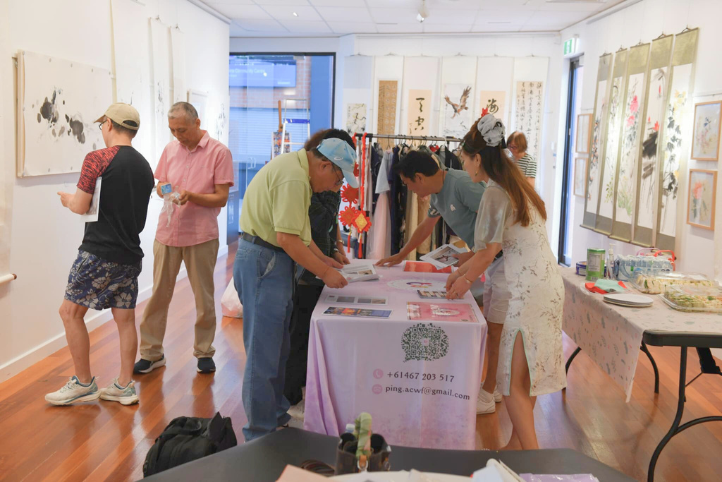
2025 Year of Snake Chinese Art Exhibition
Robina Art Gallery
21 Jan- 3 Feb 2025

Slide 23
Thank you!

